Slide 1


SRI RAMAKRISHNA INSTITUTE OF TECHNOLOGY
(An Autonomous Institution)
Pachapalayam, Perur Chettipalayam, Coimbatore- 641 010
DEPARTMENT OF COMPUTER SCIENCE AND ENGINEERING
20CS902-FYP Phase I Third Review
BATCH NO :39
ADDRESSING THE INCOME GAP CAUSED BY MIDDLEMEN IN AGRICULTURAL MARKETING THROUGH DIRECT FARMER-TO-CONSUMER SOLUTIONS
Presented by:
SOORAJ R NAIR - 71382202152
VIGNESHWARAN S - 71382202173
SARUKESH A - 71382202134
SANJAY S - 71382202130
Guided by:
MS A JAYASMRUTHI
Assistant Professor
Department of CSE

Slide 2
CONTENT OUTLINE
  Recap of Objectives
  Progress Overview
  Methodology
  System Architecture
  Implementation Details
  Result and Analysis
  Evaluation Metrics
  Future Work and Extensions
  Conclusion
  References

Slide 3
RECAP OF OBJECTIVES
Establishing a direct link between farmers and consumers fosters greater preference for organically and sustainably grown produce, thereby promoting the adoption of environmentally sustainable agricultural practices.
This approach ensures consumers have access to fresh, high-quality produce that retains its nutritional value, taste, and appearance.
Providing farmers with direct market access reduces their dependency on local intermediaries, empowering them to make informed decisions about crop production and pricing.
Enhanced market connectivity strengthens farmers' economic position and promotes greater autonomy and sustainability in their livelihoods.

Slide 4
PROGRESS OVERVIEW
Various direct farmer-to-consumer (F2C) models such as farmer markets, weekly bazaars, and Farmer Producer Organizations (FPOs) have been successfully established, enhancing farmers’ income and market access.
Adoption of digital platforms and e-commerce solutions has expanded direct market linkages, enabling transparent pricing and broader consumer reach for farmers.
Expansion of digital platforms and e-commerce solutions that enable transparent pricing and wider consumer reach for farmers.

Slide 5
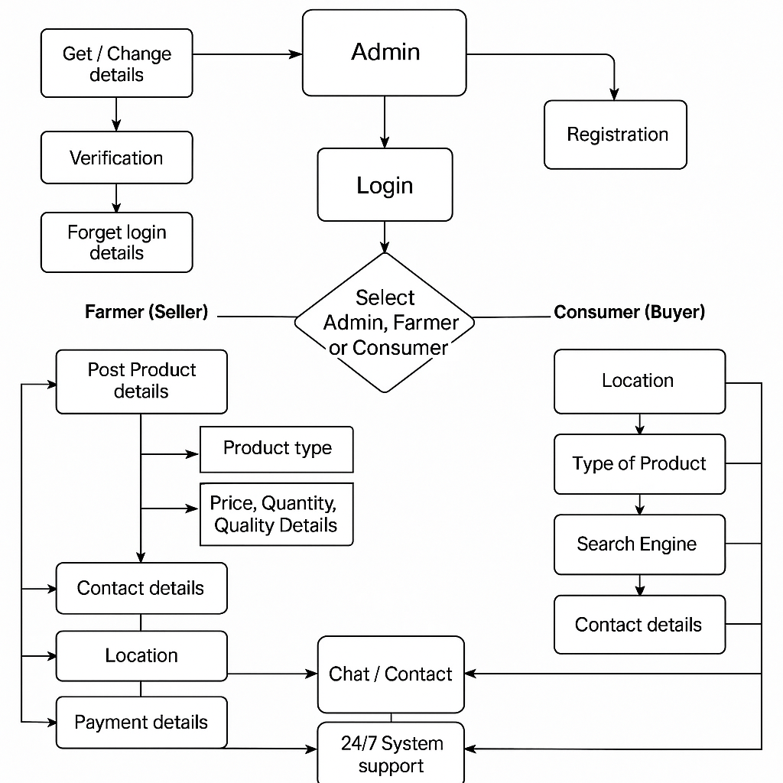
METHODOLOGY

Slide 6
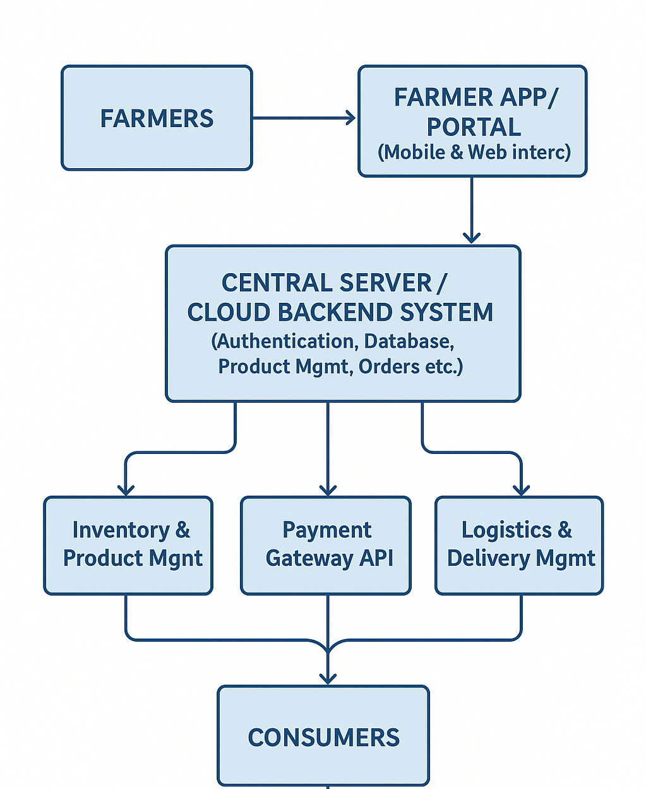
SYSTEM ARCHITECTURE

Slide 7
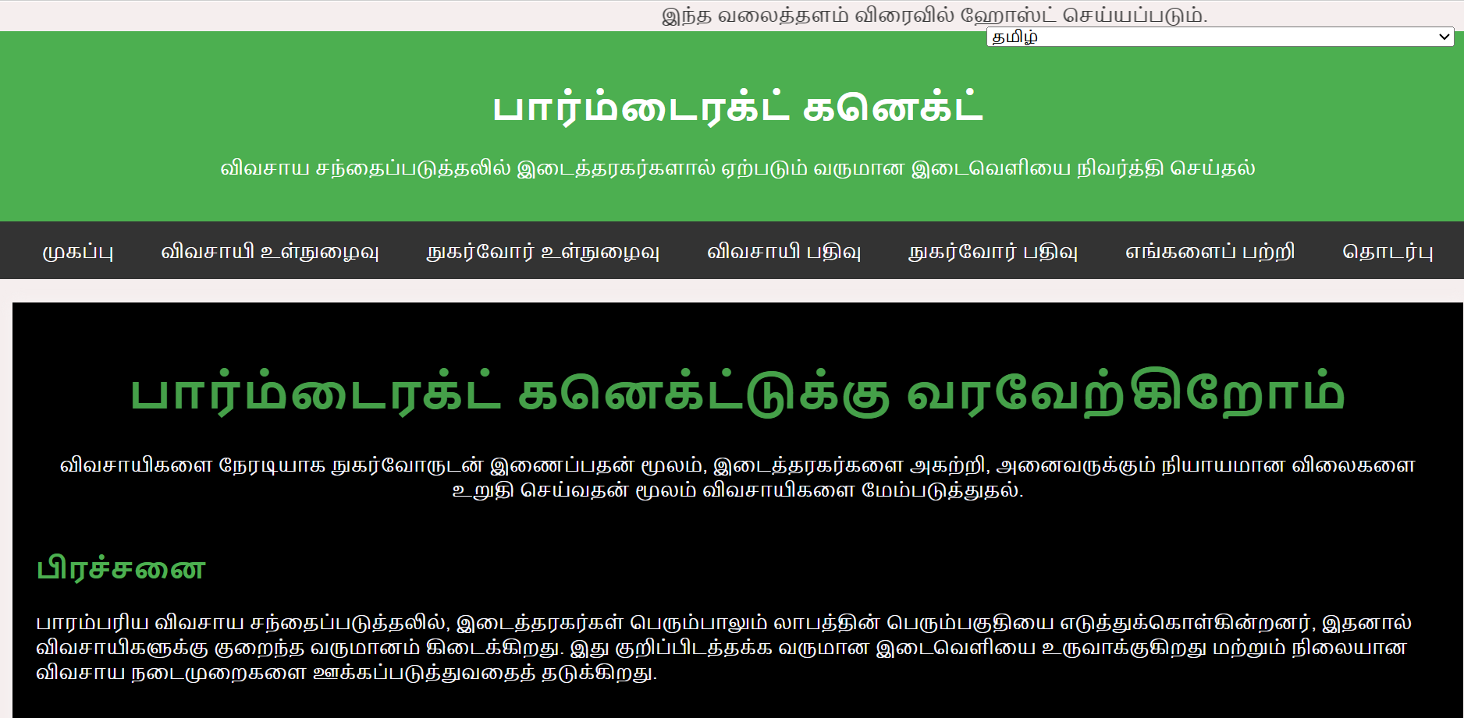
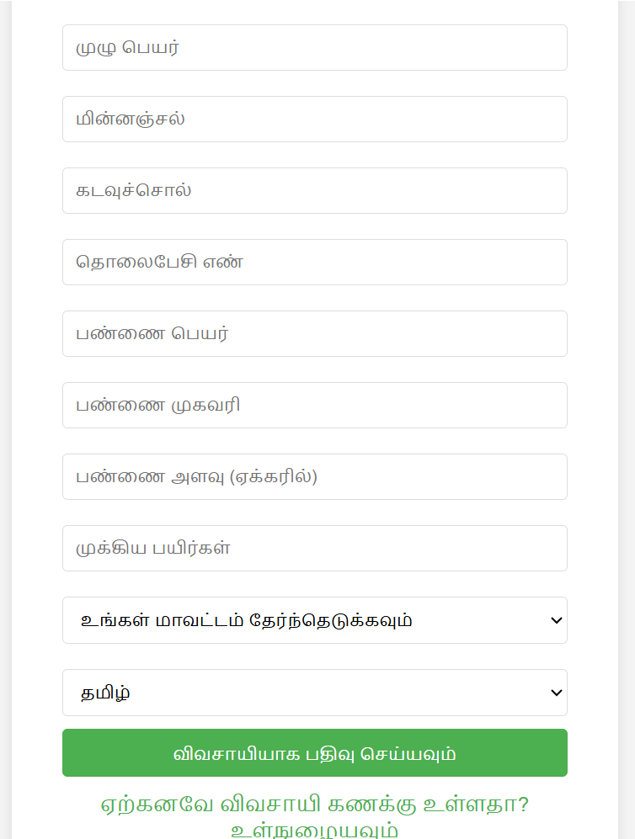
Implementation Updates

Slide 8
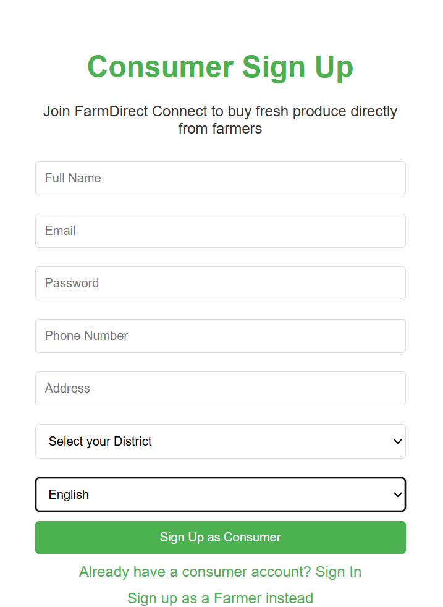
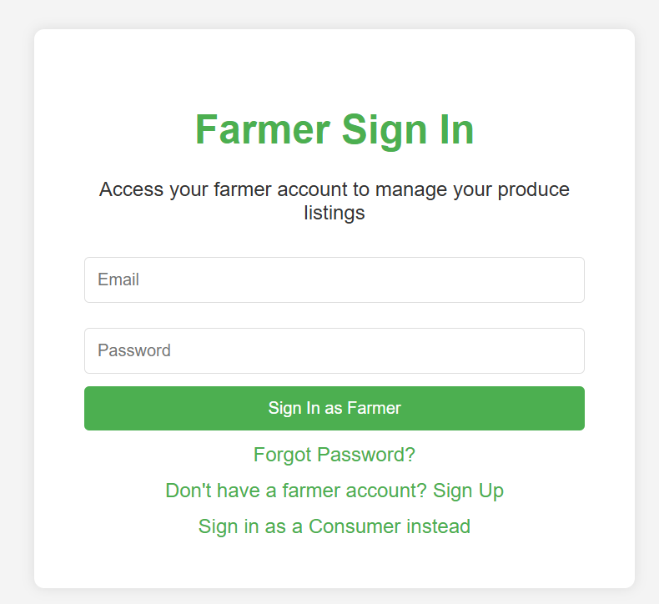
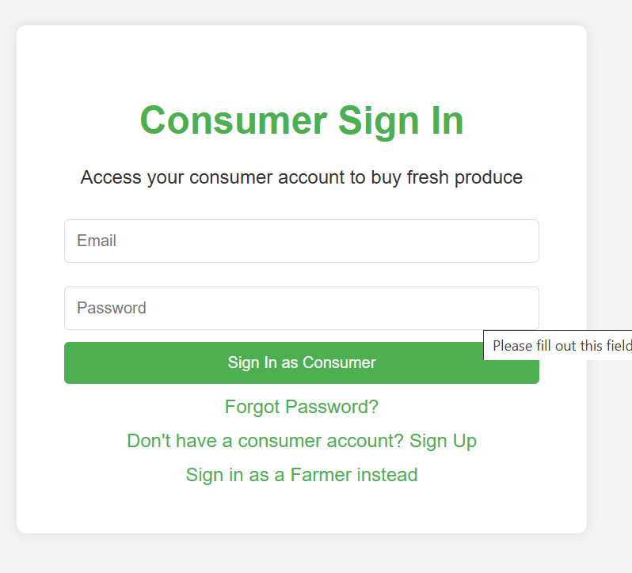
Implementation Updates

Slide 9
Results and Analaysis
Direct marketing initiatives such as farmers' markets and CSAs have enabled farmers to achieve net income improvements ranging from 10% to 30%, primarily by eliminating intermediaries and retaining a larger portion of the retail price.
Adoption of rural e-commerce platforms has boosted household incomes by 15-25%, while also contributing to narrowing income gaps within rural communities by providing flexible employment opportunities to marginalized groups.
Farmers engaged in F2C marketing benefit from increased profitability, with returns that are frequently 30-50% greater than those in traditional intermediary-led markets

Slide 10
Evaluation Metrics
Income Increase Percentage
Profit Margin per Unit
Cost Reduction from Middlemen
Sales Volume Growth
Delivery Success Rate
Post-Harvest Loss Reduction

Slide 11
CONCLUSION
    Middlemen significantly reduce farmer profits by capturing a large portion of the consumer price, creating an income gap in traditional agricultural marketing.
    Direct-to-consumer (D2C) web-based solutions offer a practical way to bridge this gap, enabling farmers to sell directly, increase their earnings, and build better customer relationships.
    By using simple digital tools—such as websites, mobile apps, and online payment systems—small and local farmers can access wider markets without relying on intermediaries.
    The project demonstrates that a well-designed platform can improve farmer income by 10–30%, while providing consumers with fresher, more affordable produce.

Slide 12
REFERENCES
D. S. V. Gowd, N. V. R. Reddy and K. Aravind, “Farmer To Consumer,” Conference Paper, Parul University, Mar. 2025.
P. Kushwaha, S. Mansoori, M. Patil, and R. Baheti “Transforming Agriculture: Enhancing Farmer-to-Consumer Connectivity Through Smart E-Commerce Platforms” Int. J. Sci. Res. Eng. Manag., vol. 9, no. 4, pp. 1–2, Apr. 2025.
A. S., A. S. V., M. M., and A. Jeyamurugan, “Web Based Application for Direct Market Access for Farmers,” Int. J. Creates. Thoughts, vol. 13, no. 4, pp. 192–197, Apr. 2025.
N. Anusha, P. S. Keerthi, M. R. Reddy, A. Ramesh, and M. R. Ignatious, “Farm to Home: An E-commerce Application for Farmers and Consumers,” in Advances in Computational Intelligence and its Applications, May 2024. DOI: 10.1201/9781003488682-5.
S. Uplaonkar and S. Biradar, “Middleman Growth in Agricultural Field and Its Impact on Farmers,” Int. J. Creat. Res. Thoughts, vol. 8, no. 3, pp. 3314–3317, Mar. 2020.

Slide 13
        THANK YOU

